Slide 1
Dell B2B Online Expansion
CIS433-309H Information Technology Project Management Group Project
By: Josh Harmon, Mitch Meyer, Tigist Gebremichael, and Tony Myers

Slide 2
Dell’s Mission Statement and Desire
“strive to provide the best possible customer experience by offering superior value; high-quality, relevant technology; customized systems; superior service and support; and differentiated products and services that are easy to buy and use”.
Dell has established an effective e-commerce application for the purpose of selling technology products to retail customers and desires to offer their extensive line of products and services via an e-commerce platform in a business to business fashion.

Slide 3
Primary Goals
Easy ordering – a custom online store that ensures access to products at the company’s discounted price.
Easy tracking – the ability to view real-time order status, online invoices, and purchase history details.

Slide 4
Project Scope
The scope of the Dell B2B Online Expansion project shall be limited to the design, development, deployment, and training on the use of the new B2B website.
Design includes: new graphics, marketing strategies, application layout, database requirements
Development Includes: Application creation using design deliverables, technology continuity, small scale testing
Deployment includes: purchasing and installing hardware, full scale testing, database merge
Training includes: training of key personal, development of training documentation

Slide 5
Project Assumptions
Must work within budget of $500,000
Project must be completed within 9 months of plan acceptance
Dell has allocated 10 personnel to complete the project
Dell has authorized budget funds for consultants on design
Project members have dell approved schedules with specific holidays off

Slide 6
Project Risks
The duration of the project is expected to take up to nine (9) months.
Project managers are of limited experience.
Project management processes and procedures are unfamiliar to team members.
Business processes, procedures, and policy requirements could be subject to substantial change.
Business organizational structure could be subject to substantial change.
Quality of existing data is uncertain.
Engagement of project sponsor is uncertain.

Slide 7
Roles and Responsibilities: Project Sponsor
Holds ultimate authority over and is responsible for the project
Approves changes to scope and provides whatever additional funds those changes require
Approves budget-related deliverables
Controls the business aspects of the project
Assists in developing the project charter and project plans
Executes formal reviews and management reviews
Disposes of issues and change requests
Makes user resources available
Approves work products
Assists in tracking action Items and budgets
Is responsible for the functional quality of the solution

Slide 8
Roles and Responsibilities: Project Manager
Controls the day-to-day aspects of the project
Develops and maintains the project charter and project plans
Executes formal reviews and management reviews
Tracks and disposes of issues
Helps resolve issues and change requests
Tracks action items and budgets
Is responsible for the quality of the product or service
Coordinates all project training
Keeps related project managers aware of changes in project scope
Executes formal reviews and management reviews
Tracks and dispose of intra-project issues
Tracks intra-project action items
Coordinates all intra-project training

Slide 9
Roles and Responsibilities: Team Leader
Manages one or more functional aspects of the project
Helps project managers with formal reviews and management reviews
Helps research issues and change requests
Helps the project manager create the work breakdown structure for his or her functional area
Helps the project manager develop the scope and estimates for his or her functional area
Maintains the scope, estimates, and work plans for his or her area
Tracks action items related to his or her functional area
Ensures the proper reporting of status by his or her team members

Slide 10
Roles and Responsibilities: Developers
Participate in the analysis and design.
Complete tasks based on the implementation plan.
Develop and test code
Collaborate with team members and management for successful completion

Slide 11
Roles and Responsibilities: Marketing
Assists the team and clarifying project requirements
Ensure alignment of marketing activities and budget.
Translate between the languages of marketing and technology
Provide the tools for measuring and reporting marketing performance

Slide 12
Roles and Responsibilities: Network Admin
Assists the team with system connectivity and configuration.
Set up hardware and software for the project implementation
Maintains secure access for the system.
Apply all enhancements, patches, and fixes to software and hardware

Slide 13
Roles and Responsibilities: Graphic Design
Prepare initial concepts to show the team how they plan to approach the project.
Develop detail design upon the approval of the initial concept.
Delivering designs on time.

Slide 14
Roles and Responsibilities: Subject Matter Experts
Exhibits the highest level of expertise in performing a specialized job, task, or skill within the organization
Understands a business process or area well enough to answer questions from people in other groups
Explains the current process to the project team and then answers their questions
Has in-depth knowledge of the subject
Represents the users’ area in identifying current or future procedures

Slide 15
Roles and Responsibilities: Senior Review board
Approves project investments
Reviews the business rationale, projects, and resources
Prioritizes projects based on specific criteria
Resolves all cross-project issues
Reviews all cross-divisional issues

Slide 16
Roles and Responsibilities: Executive Steering Committee
Discusses and resolves issues that cannot be resolved by the project team
Reviews all budget-related information regarding deliverables for the project
Is responsible for organization-wide communications
Provides guidance and mentoring to the project sponsors, project manager, and teams
Ensures that requirements of the business are adequately represented to the individual projects
Represents all affected business areas as determined by the project sponsor and project manager
Reviews and makes recommendations on scope changes
Monitors project progress

Slide 17
Communication Plan
The project managers will be responsible for facilitating communication between team members, stakeholders, and the project sponsors.
Meetings will be scheduled with high level stakeholders monthly to submit progress reports and to address any concerns or suggestions regarding the progress of the project.
Formal written progress reports will be submitted to the project sponsor at the end of each week. At the beginning of each week, a morning meeting will be held with all project members to discuss plans for work to be completed on the project for the week and to discuss any issues or conflicts that may arise.

Slide 18
Project Manager Authority
The project managers have authority over the authorized members of the project team. The project managers are also authorized to hire consultants for the design process of the project
Project managers are authorized to budget up to $500,000 for the purposes of completing the project. Managers are required to submit budget decisions to the project sponsor for approval prior to execution.
Managers are required to make period status reports as directed. Project managers operate under the direction of the project sponsor.

Slide 19
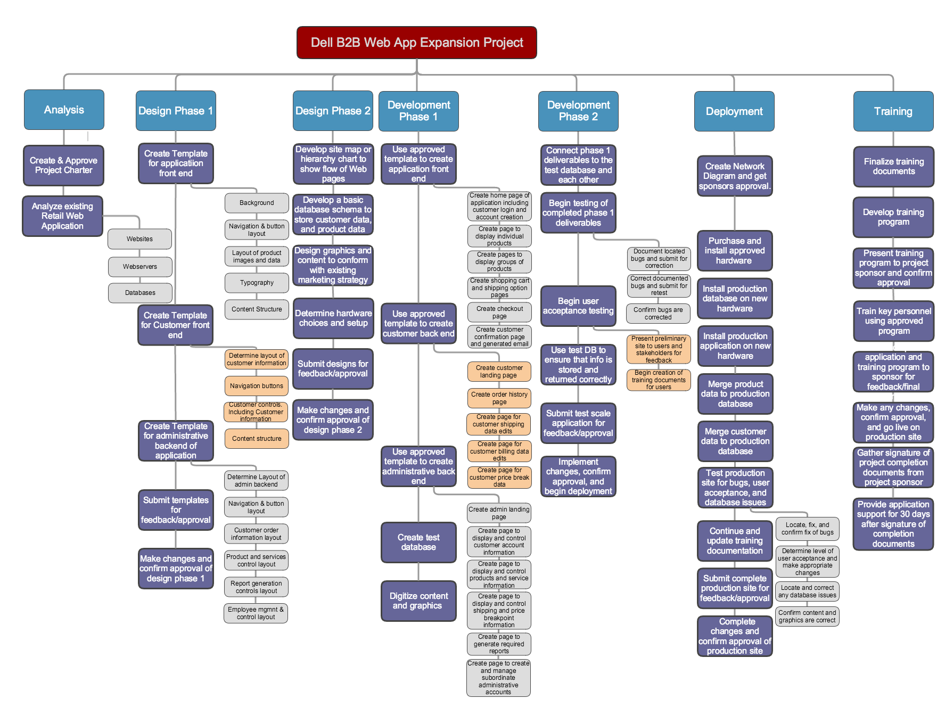
Work Breakdown Schedule

Slide 20
Project Gantt Chart
See attached 24pg attached chart

Slide 21
Cost Estimate: Hardware and Software
Name | Qty | Description | Unit Price | Total
Laptops | 10 | Ubuntu-based Dell XPS 13 laptop | $1049.00 | $10,490
Web Servers | 7 | Red Hat Enterprise Linux server | $1491 | $10,437
Database Servers | 5 | PowerEdge R320 Rack Server | $1310 | $6550
Firewall Devices | 12 | Cisco Meraki MX64 | $399.00 | $4,788
Network Devices | - |  |  | $1,000
Contingency Reserve | 1 | Unforeseen Issues | $3,320 | $3,320
 |  |  | Total: | $36,585

Slide 22
Cost Estimate: Infrastructure and Facility
Facility | Qty | Price |  | Total
Office space | 2 | $900/month |  | $8100
Networking | - | $1500 one-time expense |  | $1500
Internet service | 1 | $600/month |  | $5400
Utilities |  | $350/month |  | $3150
Contingency Reserve | 1 | $1800 |  | $1800
 |  |  | Total | 19,950

Slide 23
Cost Estimate: Labor Cost
Title | Qty | Work effort | Rate |  | Estimate cost
Chief marketing officer | 1 | 90hrs | $45 |  | $4,050
Marketing officer | 1 | 90hrs | $38 |  | $3,420
Senior administrator | 1 | 100hrs | $58 |  | $5,800
Network administrator | 2 | 40hrs | $45 |  | $1800
Senior application analysis | 1 | 1160hrs | $60 |  | $69,600
Senior application developer | 1 | 1160hrs | $60 |  | $69,600
Application developer | 1 | 1160hrs | $50 |  | $58,000
Graphic design specialists | 2 | 336hrs | $50 |  | $16,800
Contingency Reserve | 1 | 450hrs | $50 |  | $22,500
 |  |  |  | Total | $251,570

Slide 24
 |  |  |  |  | Steps will be highlighted if A and R are not assigned.
 |  |  |  |  | R: | Does the step
RACI Charts |  |  |  |  | A: | Accountable for the step
 |  |  |  |  | C: | Consulted with before the step
 |  |  |  |  | I: | Informed when the step is completed
 |  | Project: | Dell Web App Expansion
 |  | PROCEDURE
 |  | DEPARTMENT | Operations
 |  | UPDATED | 12/8/15
 |  | STEP | DESCRIPTION | Marketing | Networking |  | Developer | Project Manager | Sponsor
 |  | 1 | Analysis | C |  | R |  | IA | IA
 |  | 2 | Design Phase 1 | RC | C | RA |  | IA | I
 |  | 3 | Design Phase 2 | C | C | RA |  | IA | I
 |  | 4 | Development Phase 1 |  | C | RA |  | IA | I
 |  | 5 | Development Phase 2 |  | C | RA |  | IA | I
 |  | 6 | Deployment | I | R | AI |  | IA | I
 |  | 7 | Training | RI |  | R |  | RA | I

Slide 25
Project Resource Allocation
Key: R = responsible; A = Accountable; C = Consult; I = Inform;
 | Marketing Team | Networking and Infrastructure | Developer Team | Project Management | Project Sponsors
Project Analysis | C |  | C | R, A | I, A
Design – Phase 1 | C, R | C | R, A | I, A | I
Design – Phase 2 | C | C | R, A | I, A | I
Development – Phase 1 |  | C | R, A | I, A | I
Development – Phase 2 |  | C | R, A | I, A | I
Deployment |  | R | A, I | I, A | I
Training | R, I |  | R | R, A | I

Slide 26
Risk Management
NO. | Rank | Risk | Description | Category | Root Cause | Triggers | Potential Responses | Risk Owner | Probability | Impact | Status
1 | 1 | Website design | The project design cannot be completed on time. Phase 2 design could be delayed. | Software | Scheduling Error |  | Crash the schedule Cancel the project. Shorten the Scope | Developers Phase 2 | 16 | High | Open
2 | 2 | Customer involvement | The customers are not ready for the change. | Project | Schedule change |  | Delay the project Help get customers ready | Marketing | 12 | Low | Closed
3 | 3 | Loss of key stuff |  | Project | User Error |  | Recover most recent files and update them. | Project manager | 3 | Low | Open
4 | 4 | Graphic Design issue | The application design was not reviewed by the architect | Software |  |  | Submit design for approval and make necessary changes | Developers phase 1 | 23 | High | Open
5 | 5 | Tool license expiry | License expires in 5 month. | Project |  |  | Renew Licence | Network and infrastructure | 26 | High | Open
6 | 6

Slide 27
Risk Probability Matrix
 |  |  | Impact
 |  | Low | Medium | High
 | High | Risk 3
Probability | Medium | Risk 2 |  | Risk 1
 | Low |  |  | Risk 4 Risk 5

